Slide 1
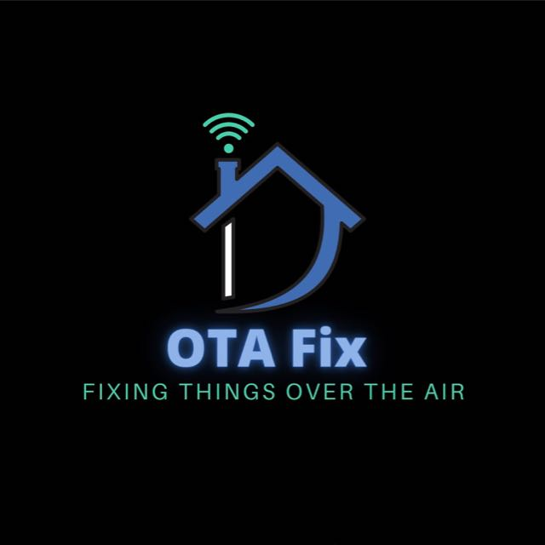
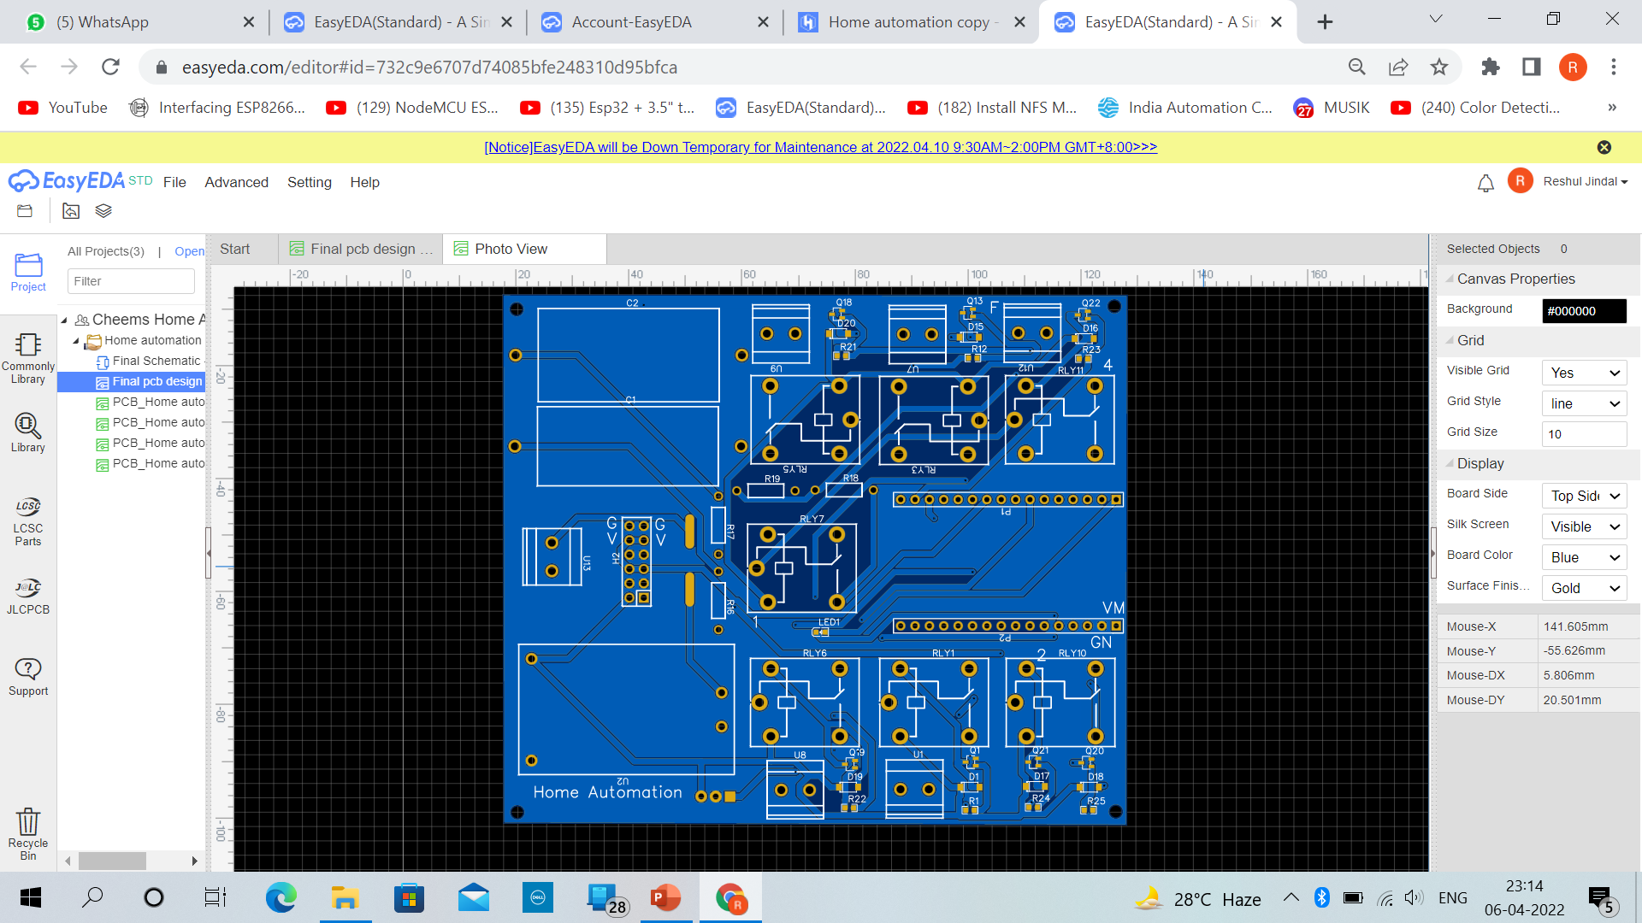
OTA–Fix

Slide 2
⚪ Executive Summaries
Bootstrapped the startup with an initial total investment of INR 10,000 from all the founders to move from ideation to execution phase and fabricate an operational product.
Fully operational prototype of the product completed within 6 months of ideation(July 2022-December 2022).
Beta version of automation app functional and the software team is working on a fully functional commercial app, scheduled to be completed by the end of April 2023.
Deployed firebase service by using cloud services to have an operational database over the cloud.
Pan India Market survey conducted with a sample size of over 250 individuals to get an idea of the market sentiment about the product and the ease of customer acquisition as well as their willingness to pay to help us chart out our marketing strategy and financial model respectively.

Slide 3
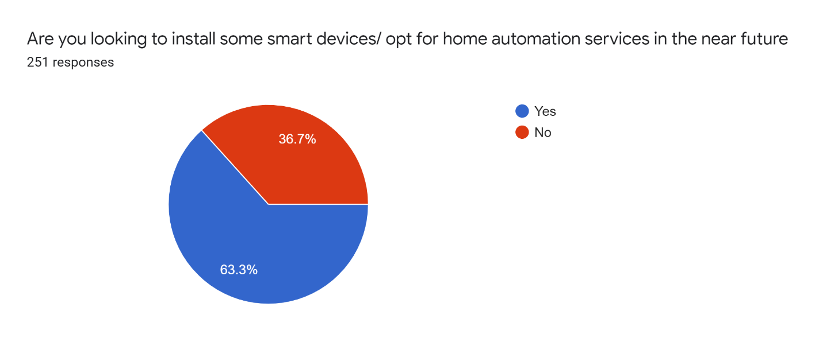
⚪ Market Opportunity :
Willingness to buy: When asked if our surveyors were looking to install some smart devices/ opt for home automation services in the near future, more than 60% said - YES!
Smart Cities: as a concept and a way of living is gaining traction across the country and being promoted by the government as well our product finds a product market fit for people as well as companies looking to save their time and effort and acquire smart living solutions to add to their up-to-date lifestyles.
Based on the findings from the Market survey conducted(sample size :250+ unique individuals across India)
SKILL INDIA : With the product that we aim to sell and the market that we aim to tap in(wholesale real estate developers as well as individual retail clients) we would also be creating a lot of skill based jobs which will in turn keep our CSR on track from the very beginning as a firm

Slide 4
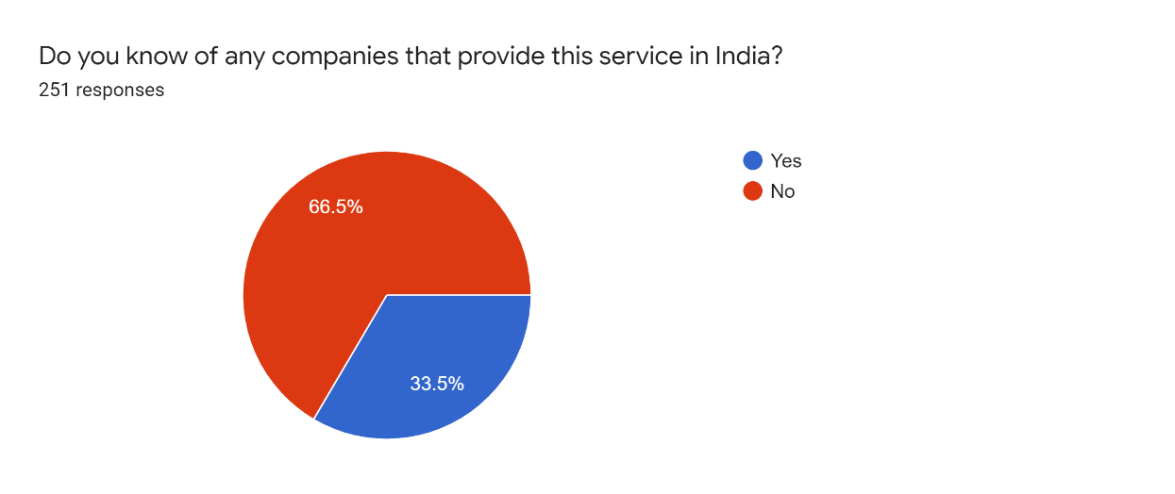
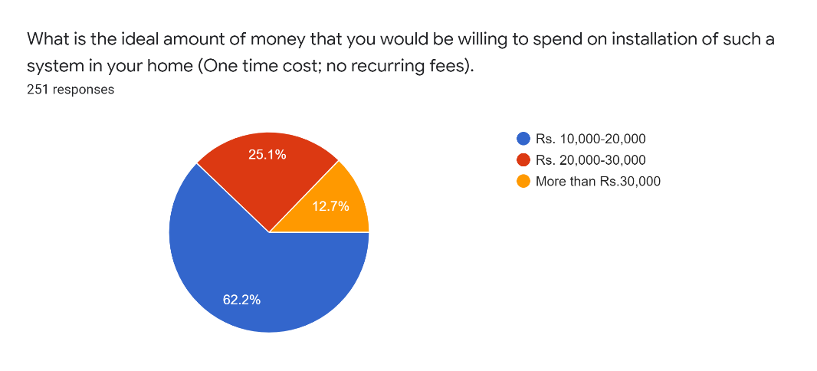
⚪ Distinctive Competence :
There is lack of awareness among customers regarding the sellers of such technology which gives us the First Mover Advantage to ensure maximum customer acquisition to create sales and generate revenue during initial phase.
The price point at which we sell our product covers a major share of the Indian market thus outplaying rival competition which sell similar products but way outside of the average consumer’s budget
Creating jobs at large scale by employing skilled technicians for installation
Based on the findings from the Market survey conducted(sample size :250+ unique individuals across India)

Slide 5
⚫ What is the value proposition :
Our customers
primarily include families in the upper middle / high income class groups usually living in metropolitan /semi urban setups. We aim to primarily focus on the wholesale market and dealing with real estate developers to take us on board in their projects this will help us cater to a large clientele and in turn help the developers to convince their clients that they provide smart and modern living amenities .
The product provides the customers with an ergonomic and a modern way to control their appliances and operate their homes at the touch of a button and enhance their experience of living in their homes.
Finances As sophisticated our technology may seem our pricing is particularly attractive as compared to our competitors in the smart home consumer electronics which makes sure that customers can have access to modern and smart living without having to worry about making a deep hole in their pockets.

Slide 6
⚫ Team
Our team is a group of hardworking engineers with an entrepreneurial mindset, working not just to provide you with best in class technology but also to ensure we enhance your day to day experience even when you engage in repetitive activities either at home or in your workplace.
Harshit Kapoor- Founder, CEO
The man behind the vision of fixing things Over The Air. Harshit is a highly productive and energetic young entrepreneur.
Daksh Narula- Founder, Head- Hardware design He has some of the best insights about the equipment and it’s shortcomings, which makes him a great in house critic for our product and services. This man speaks less in words and more in circuits. Ask him about any equipment in the market, he will tell you it’s past, present and future.
Ayush Yadav- Founder, Head- Software Design
He is our guru in the software world and his programming skills help us bring all our unique ideas to life.
Aditya Khulbe- Founder, Product Manager
He is the guy who does the talking. From auditing and reviewing the team ideas to managing how the finances and our customer experience works he brings together all the hard work that the team puts and tries to put up a great show for the customers

Slide 7
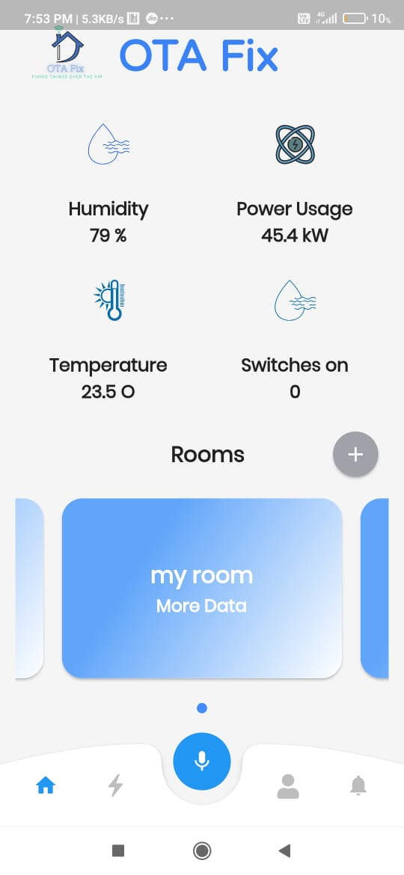
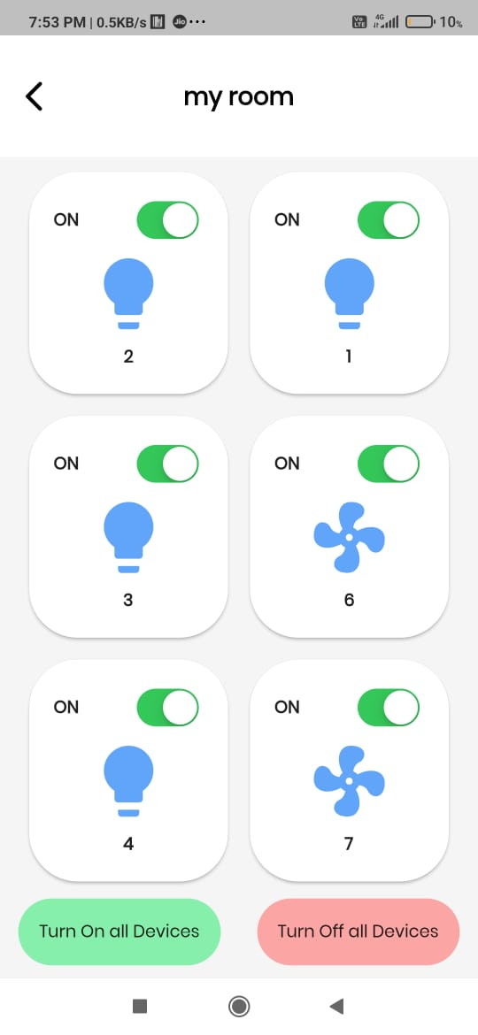
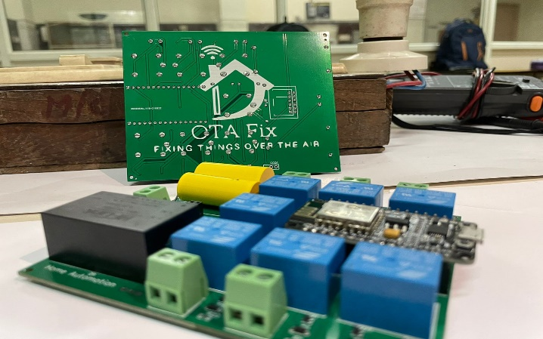
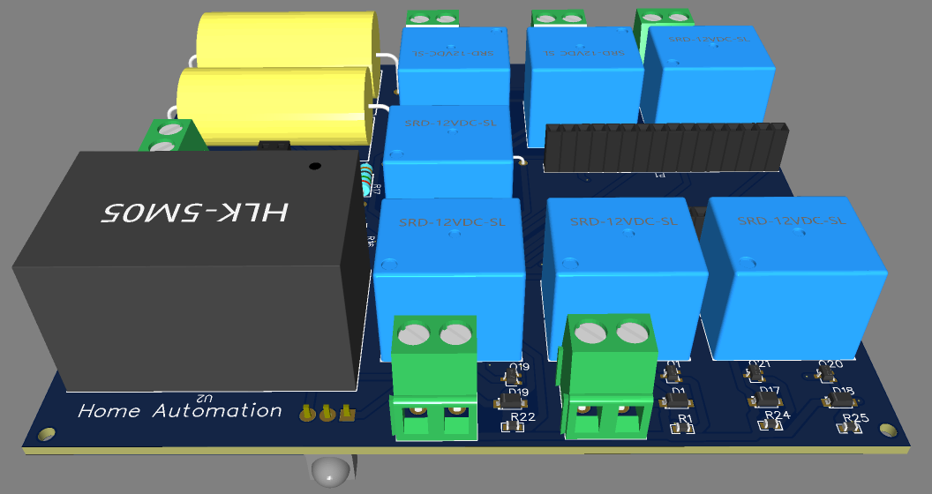
⚪ Working product and APP UI
3D view of PCB on software

Slide 8
⚪ Market Sizing
TAM
Total Available Market
$ 70 Billion
SAM
Serviceable Available Market
$ 1.8 Billion
SOM
Serviceable Obtainable Market
$ 720 Million

Slide 9
⚪ Business Model / Financial Model for bulk manufacturing
Depending upon the quantity of parts we order: Cost incurred in furnishing 20 units- 1.Procurement of Components- INR 13,000 2.Assembly and installation- INR 23,000 3.Miscellaneous(Packaging, Wiring/remotes/ app/Customer support etc)-INR 8000
Total- INR 44,000(20 units)
Cost per unit(per unit translates to per room in a house)- 44,000/20= INR 2200 Selling price- INR 7,999- 10,999 (depending upon variants) Surprisingly enough this selling price is 40% cheaper than some our competition on a per room installation basis, while still providing us with a 3x profit to become profitable and achieve breakthrough significantly smaller amount of time.

Slide 10
⚫ Risk factors to execution
Procurement of parts We employ a wide range of electronic equipment to make our final product. In the case of a component failure we need to have enough parts stacked up to ensure that our customers do not have a bad user experience and we are able to provide them with best service.
Customer acquisition Since our product is still not a mainstream product, we might have to spend some time explaining what our product does in order to bring them on board and be a part of our ecosystem we aim to build over the coming years.
Man power for after purchase installation/ service Since we primarily deal with a product and not a service, we would have to rely either on 3rd party facilitators to arrange for technicians/ hire them on our own payroll who install this technology and give it to the end user

Slide 11
⚫ Funding objective and use of funds
Facilitate procurement of electronic components in bulk to maintain a healthy inventory.
To facilitate research and development for innovations and upgrades to our product in the future so that we can make the range of products feature rich and cater to a bigger market.
We utilize firebase cloud services for our database however these services are not entirely free and require certain remuneration from us to continue to use them.
To market our product across various forums and gain traction to eventually gain new customers.

Slide 12
⚫ References
In house market survey using the following form - https://forms.gle/BMp94xxzA1SzdXKz8
Firebase services
Technical support-(Mention internet knowledge vid if any/ NSUT lab names/ prof names)
Design inspiration (optional)

Slide 13
Thank You
NSIT Technology Business Incubator Startup Presentation

